Slide 1
Vulcan Defect Status
Mar. 28, 2016
Tao Wu, Wen Yi Gao

Slide 2
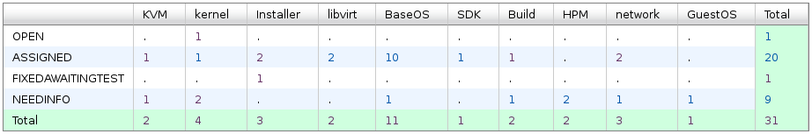
Vulcan - Open Defects
31 open defects exluding 15 HVM bugs.
13 defects new opened in the last two weeks. We solved 11 defects in the past two weeks.
Defect statistics:

Slide 3
Vulcan – High Priority Defects
No |  |  |  | Comp | Summary | Status | Comment
1 | 139041 | P1 | Ship issue | BaseOS | hardware performance counters and respective tools missing | ASSIGNED | - Patch to add cpumf tools is available. - Waiting for MCP to build a package to test.
2 | 138880 | P1 | High | BaseOS | zgetdump returns "No valid dump found" on SCSI dump device | ASSIGNED | - Patch to add support for partition based dump to zgetdump is available.
3 | 126365 | P2 | High | kernel | Default Network Performance is less than half of line speed | NEEDINFO | - Waiting for the results of the performance test. - Patch will be pushed upstream once the test passes.

Slide 4
Vulcan – All Defects
422 defects excluding 15 HVM defects opened in the Vulcan Bugzilla until now.

